Slide 1
Keylogger and Security
Presented By:
G J Philip Ajay Kumar – Computer Science and Engineering ,
DMI College of Engineering

Slide 2
OUTLINE
Problem Statement
Proposed System/Solution
System Development Approach
Algorithm & Deployment
Result (Output Image)
Conclusion
Future Scope
References

Slide 3
Problem Statement
In today’s digital age , where cybersecurity threats loom large , one of the significant concerns is the proliferation of keyloggers , stealthy software tools designed to monitor and record keystrokes on a user’s computer without their knowledge . Keyloggers pose a serve threat to individuals and organizations as they can capture sensitive information such as password , credit card details , and other personal data , leading to identity theft , financial loss , and privacy breaches.

Slide 4
Proposed Solution
The provided code is a basic implementation of a keylogger using Python's tkinter for GUI, pynput for listening to keyboard events, and json for storing the logged keys. Here’s a proposed system for enhancing this keylogger:
Improve File Handling:
Ensure that the key logs are appended to the file rather than overwritten. This prevents the loss of previously logged keys.
Implement error handling for file operations to handle scenarios such as file access issues.
Enhance Key Logging:
Include timestamping for each logged key to provide temporal context.
Record additional metadata such as the active window/application at the time of key press for better contextual understanding.
Add Encryption:
Encrypt the logged data to protect user privacy. Use a secure encryption algorithm like AES.
Implement a mechanism to securely store and retrieve encryption keys.
Implement Stealth Mode:
Allow the keylogger to run in stealth mode, hiding its presence from the user.
This can involve hiding the GUI, running the script in the background, and using inconspicuous filenames.
Remote Reporting:
Implement functionality to periodically send logged data to a remote server.
Use secure communication protocols like HTTPS to transmit data securely.
Ensure proper authentication and authorization mechanisms to prevent unauthorized access to the remote server.

Slide 5
.
Add Persistence:
Make the keylogger persistent so that it starts automatically upon system boot.
Employ techniques like registry modifications (for Windows) or cron jobs (for Unix-based systems) to achieve persistence.
Improve User Interface:
Enhance the user interface to provide better feedback and control options.
Include features like a log viewer within the GUI itself for easier monitoring of logged data.
Implement Whitelisting/Blacklisting:
Allow the user to specify certain keys or applications to exclude from logging (whitelisting).
Implement blacklisting to ignore sensitive keystrokes or applications.
Ensure Legal Compliance:
Add a disclaimer or notification to inform users about the presence of the keylogger.
Ensure compliance with relevant laws and regulations regarding monitoring and privacy.
Testing and Debugging:
Perform thorough testing to ensure the keylogger works as intended across different operating systems and environments.
Implement robust error handling and logging to facilitate debugging and troubleshooting.
These enhancements will help make the keylogger more robust, secure, and user-friendly. However, it's crucial to use such tools responsibly and ethically, respecting user privacy and legal regulations.

Slide 6
System Approach
The "System Approach" section outlines the overall strategy and methodology for developing and implementing the keylogger security system. Here's a suggested structure for this section:
Python IDE
‘tkinter’ for GUI
‘pynput’ for capturing keyboard events
‘json’ for handling JSON files

Slide 7
Algorithm and Deployment
In the Algorithm section, we outline the machine learning algorithm chosen for detecting keyloggers and the deployment strategy for the keylogger detection and prevention system. Here's the structure for this section:
Algorithm Selection:
Utilize a heuristic-based approach combined with machine learning techniques for effective keylogger detection.
Justification: This approach balances accuracy and efficiency, suitable for real-time detection across diverse computing environments.
Data Input:
The algorithm analyzes real-time keyboard events captured using the Pynput library, incorporating contextual information like application focus and timestamps.
Training Process:
Train the algorithm using a dataset of known keylogger activities, employing feature extraction and anomaly detection techniques.
Implement continuous learning mechanisms to adapt to evolving threats and user behavior changes.

Slide 8
.
Prediction Process:
Real-time monitoring detects suspicious activity, triggering alerts for user action.
Refine detection accuracy over time through user feedback.
Deployment:
Deploy the system as a standalone application or integrate it into existing security suites.
Consider compatibility, scalability, and user-friendliness during deployment.
Through this approach, Aim to develop a robust and adaptable keylogger detection and prevention system capable of effectively safeguarding user privacy and security in today's digital environment.

Slide 9
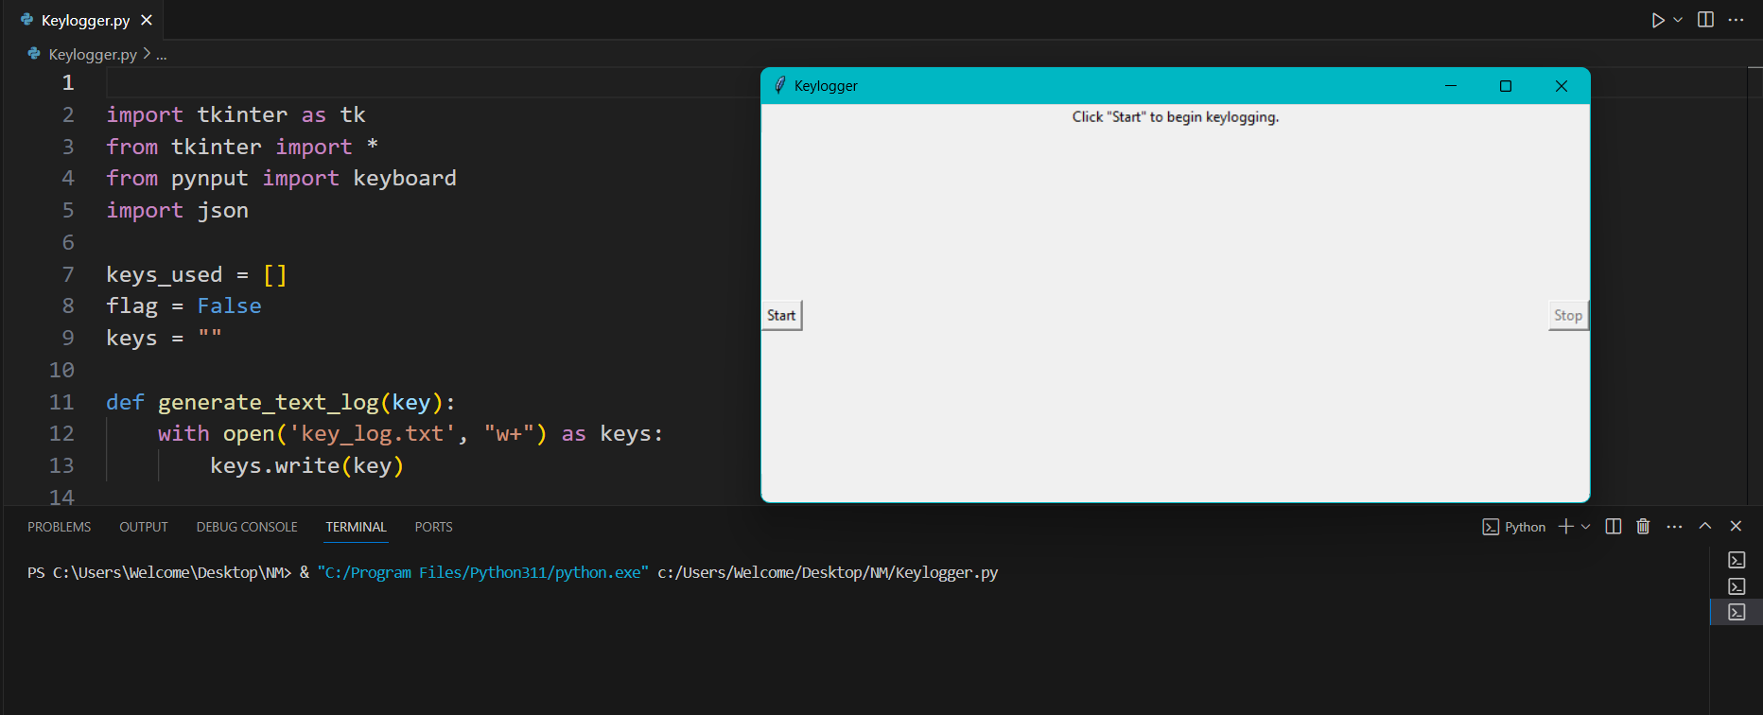
Result
.

Slide 10
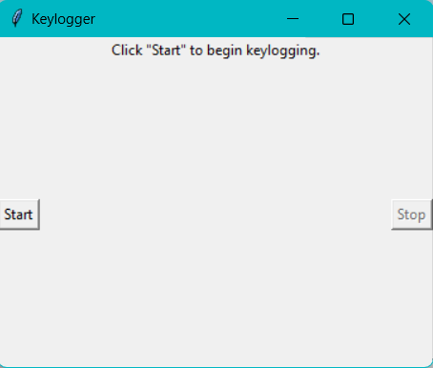
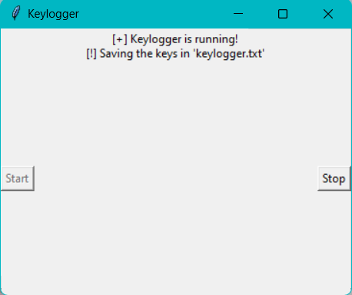
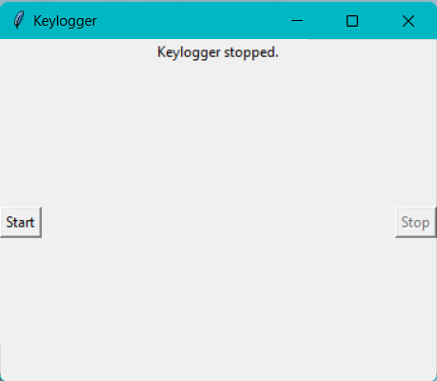
.

Slide 11
Conclusion
Employing robust antivirus and anti-malware software can help detect and remove keyloggers. Additionally, regularly updating operating systems and software patches can close vulnerabilities exploited by keyloggers.
The proliferation of keyloggers in today's digital landscape poses a serious threat, enabling the surreptitious monitoring and recording of keystrokes.
This sensitive information, including passwords and financial data, putting individuals and organizations at risk of identity theft, financial harm, and privacy violations.
Addressing this issue demands heightened cybersecurity measures, awareness, and collaborative efforts to mitigate the impact of keyloggers on digital security.

Slide 12
Future scope
Optimizing the Algorithm:
Continuously optimize the detection algorithms to improve performance and accuracy, leveraging techniques such as feature selection, ensemble learning, and deep learning architectures.
Implement advanced anomaly detection algorithms to identify sophisticated keylogger variants and zero-day threats effectively.
Expanding System Coverage:
Extend the system's coverage to encompass multiple cities or regions, enabling organizations and governments to scale the solution for broader cybersecurity protection.
Collaborate with industry partners and cybersecurity experts to develop localized threat intelligence and response strategies tailored to specific geographical areas.
Advancements in machine learning and artificial intelligence may lead to more sophisticated detection techniques for identifying and mitigating keyloggers. Furthermore, the integration of biometric authentication and encryption technologies can enhance security against keystroke monitoring threats.

Slide 13
References
Python Software Foundation. (2024). Python Language Reference, version 3.9. Available at https://www.python.org/doc/versions/.
Tkinter Documentation. (2024). Tkinter GUI toolkit documentation. Available at https://docs.python.org/3/library/tkinter.html.
Pynput Documentation. (2024). Pynput documentation for monitoring keyboard events. Available at https://pynput.readthedocs.io/en/latest/.
JSON Documentation. (2024). JSON library documentation for data serialization and deserialization. Available at https://docs.python.org/3/library/json.html.
List and cite relevant sources, research papers, and articles that were instrumental in developing the proposed solution. This could include academic papers on bike demand prediction, machine learning algorithms, and best practices in data preprocessing and model evaluation.

Slide 14
THANK YOU

